Slide 1

Data Analysis
Hilmi

Slide 2

EXECUTIVE SUMMARY
The presentation analyzes the latest Stack Overflow Developer Survey to identify current and emerging technology trends.
Key insights focus on the top programming languages and databases currently used and preferred in the near future.
The survey reflects responses from thousands of developers across roles, regions, and industries.
The findings are visualized through charts and dashboards, aiding stakeholders in decision-making regarding tech stack planning, hiring, and training.
Trends such as the rising popularity of Rust and Go and the sustained dominance of JavaScript and SQL are highlighted.

Slide 3
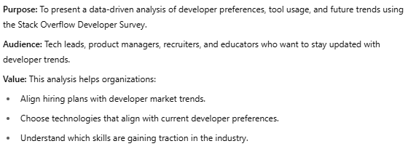

INTRODUCTION

Slide 4
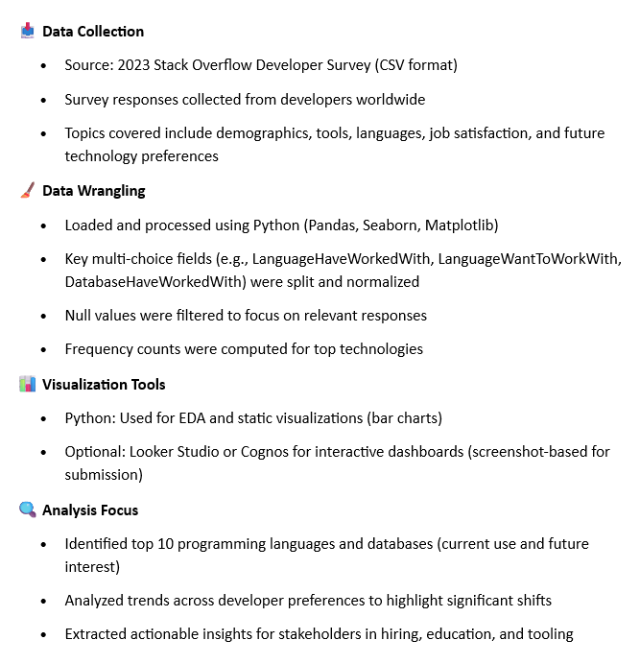

METHODOLOGY

Slide 5
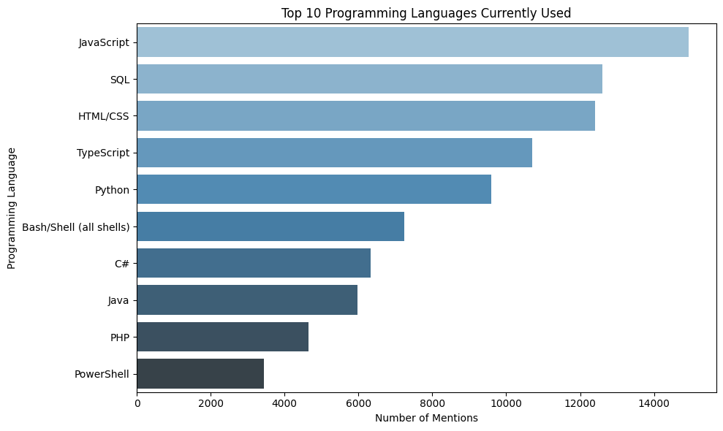
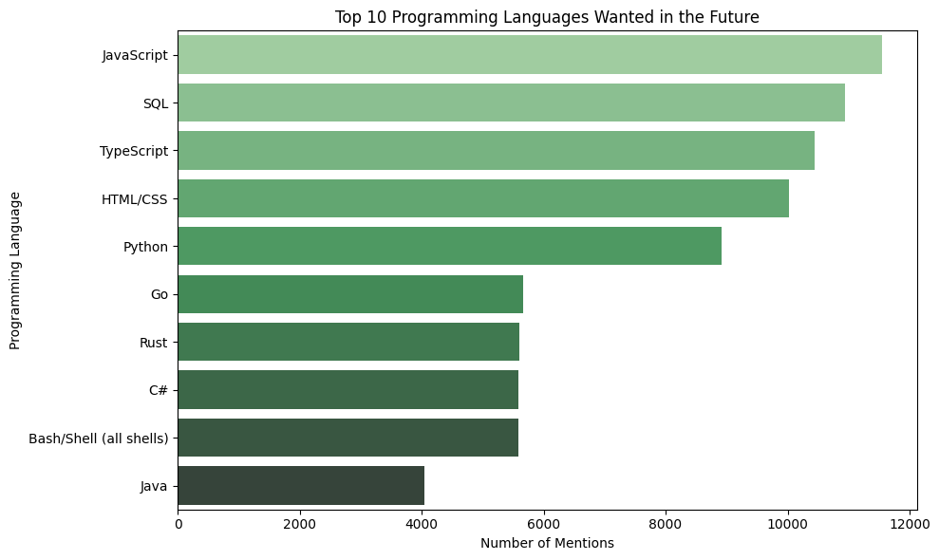
PROGRAMMING LANGUAGE TRENDS
Current Year
Next Year

Slide 6
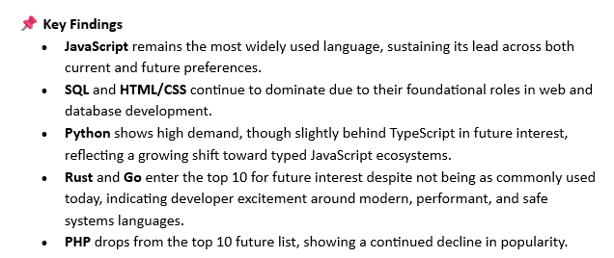
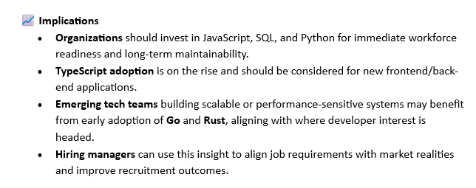
PROGRAMMING LANGUAGE TRENDS - FINDINGS & IMPLICATIONS
Findings
Implications

Slide 7
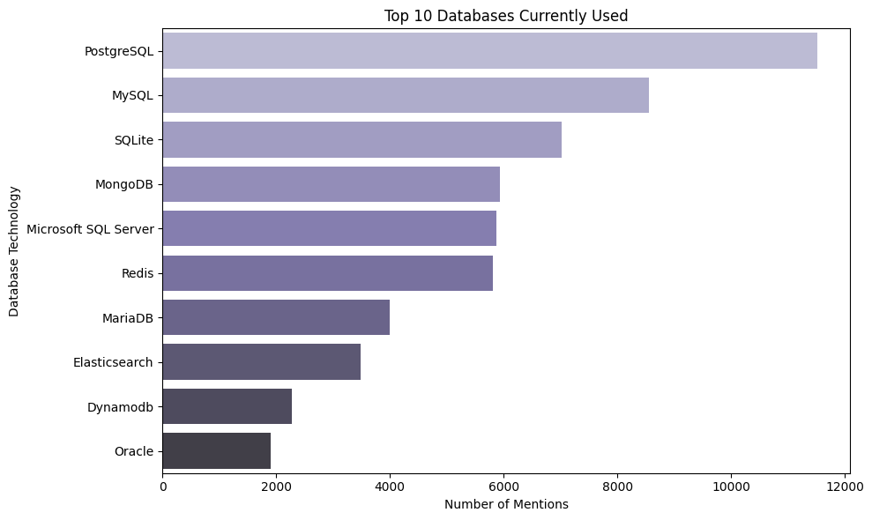
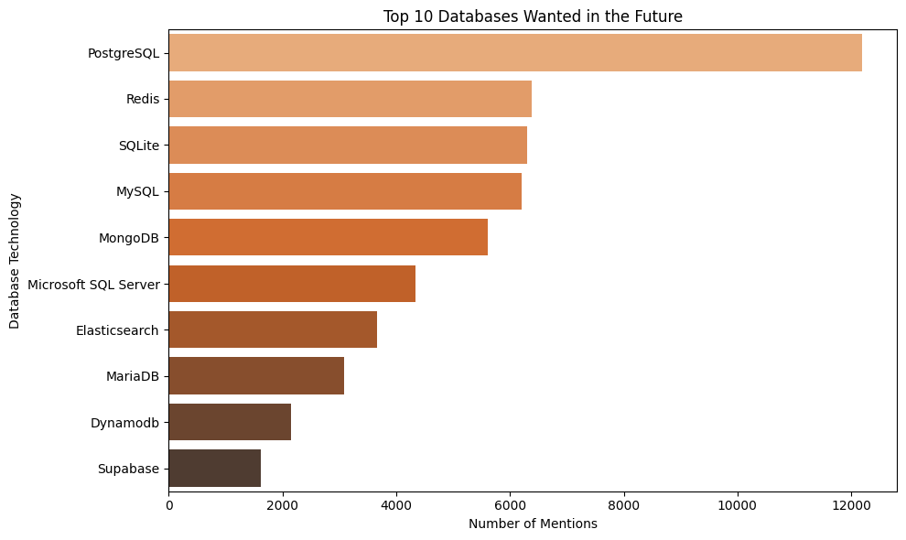
DATABASE TRENDS
Current Year
Next Year

Slide 8
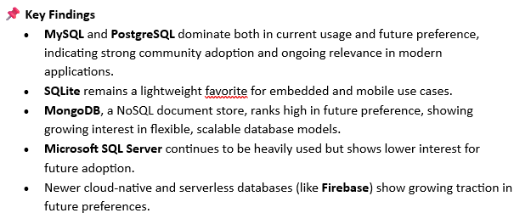
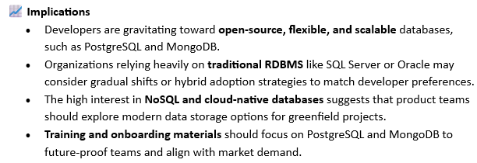
DATABASE TRENDS - FINDINGS & IMPLICATIONS
Findings
Implications

Slide 9

DASHBOARD

Slide 10
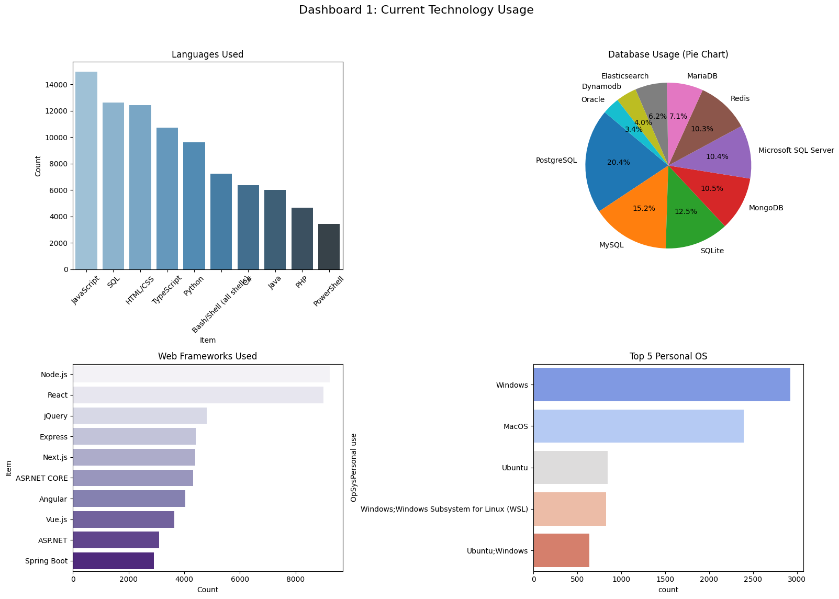
DASHBOARD TAB 1

Slide 11
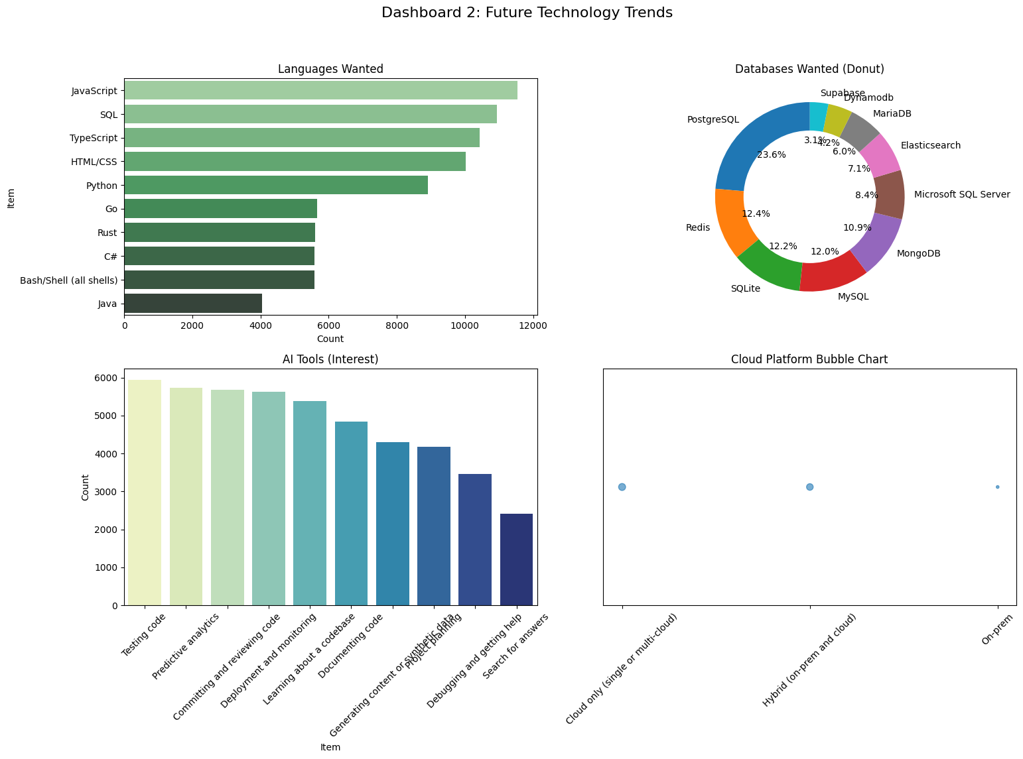
DASHBOARD TAB 2

Slide 12
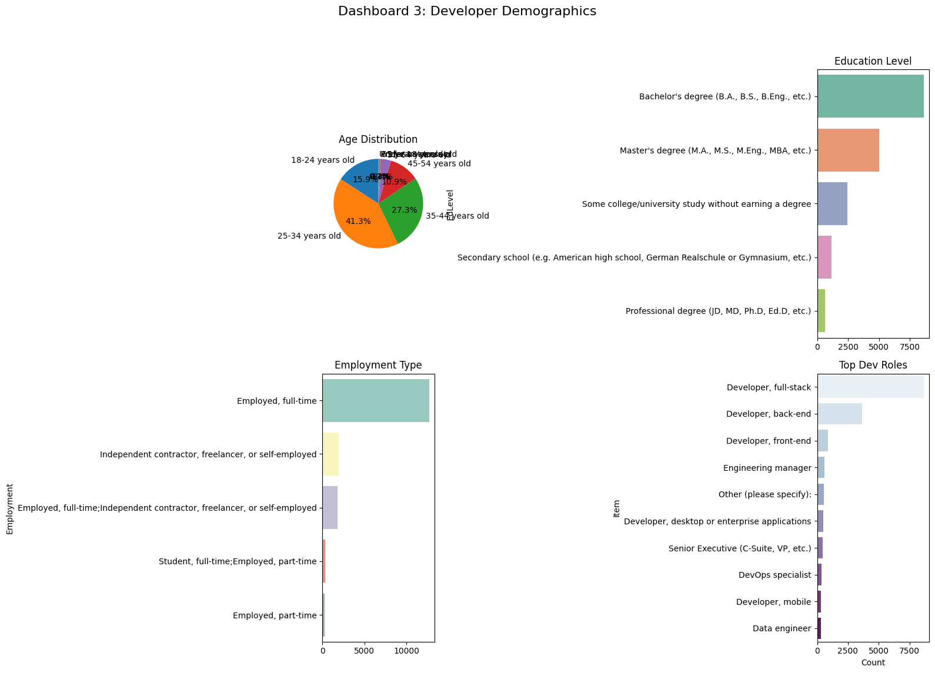
DASHBOARD TAB 3

Slide 13
DISCUSSION

Slide 14
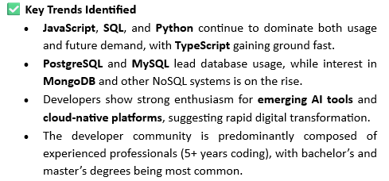
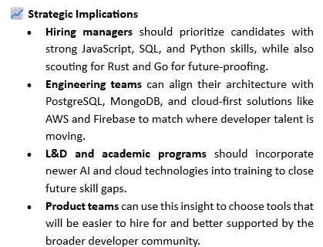

OVERALL FINDINGS & IMPLICATIONS

Slide 15
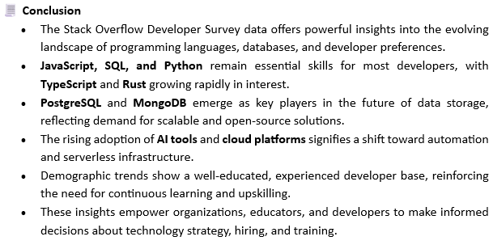

CONCLUSION
Point 1
Point 2
Point 3
Point 4

Slide 16

APPENDIX
Years of Professional Coding Experience
Most Admired Programming Languages
Top AI Tools Developers Are Interested In
General Implication

Slide 17
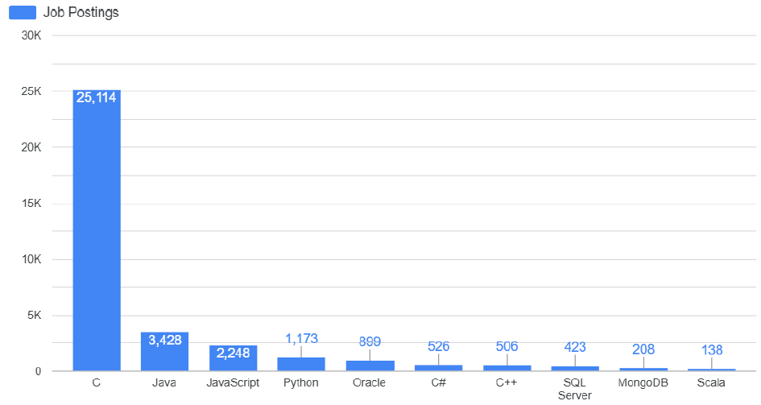
JOB POSTINGS

Slide 18
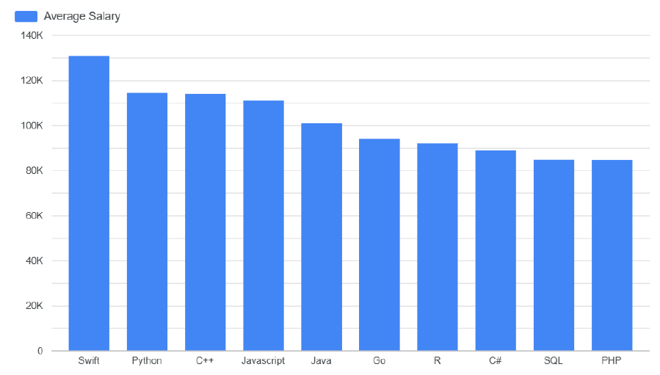
POPULAR LANGUAGES

